Slide 1
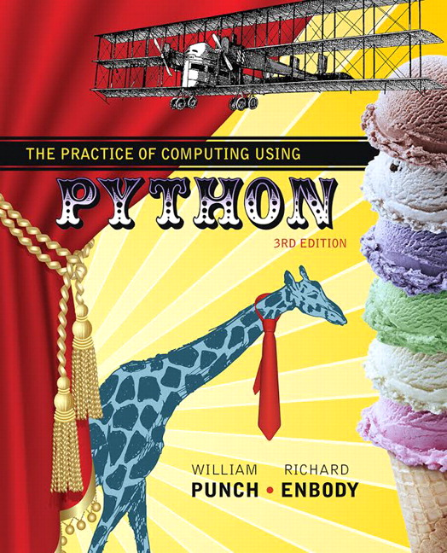
The Practice of Computing Using Python
Third Edition
Chapter 5
Functions - QuickStart
Copyright © 2017, 2013, 2011 Pearson Education, Inc. All Rights Reserved
Notes:
If this PowerPoint presentation contains mathematical equations, you may need to check that your computer has the following installed:
1) MathType Plugin
2) Math Player (free versions available)
3) NVDA Reader (free versions available)

Slide 2
What is a function?

Slide 3
Functions
From Mathematics we know that functions perform some operation and return one value.
They “encapsulate” the performance of some particular operation, so it can be used by others (for example, the sqrt() function)

Slide 4
Why have them?
Support divide-and-conquer strategy
Abstraction of an operation
Reuse. Once written, use again
Sharing. If tested, others can use
Security. Well tested, then secure for reuse
Simplify code. More readable.

Slide 5
Mathematical Notation
Consider a function which converts temperatures in Celsius to temperatures in Fahrenheit.
Formula:
Functional notation:

Slide 6
Python Invocation
Math: F = celsius_to_Fahrenheit(C)
Python, the invocation is much the same
Terminology: cel_float is the argument

Slide 7
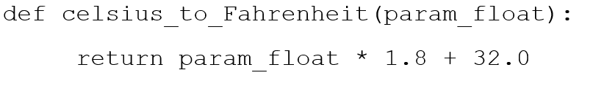
Function Defintion (1 of 2)
Math:
Python
Terminology: cel_float is the parameter

Slide 8
Function Defintion (2 of 2)
Figure 5.1 Function Parts

Slide 9
Return Statement
The return statement indicates the value that is returned by the function
The statement is optional (the function can return nothing). If no return, function is often called a procedure.

Slide 10
Code Listing 5.1 : Temp Convert

Slide 11
Triple Quoted String in Function
A triple quoted string just after the def is called a docstring
docstring is documentation of the function's purpose, to be used by other tools to tell the user what the function is used for. More on that later

Slide 12
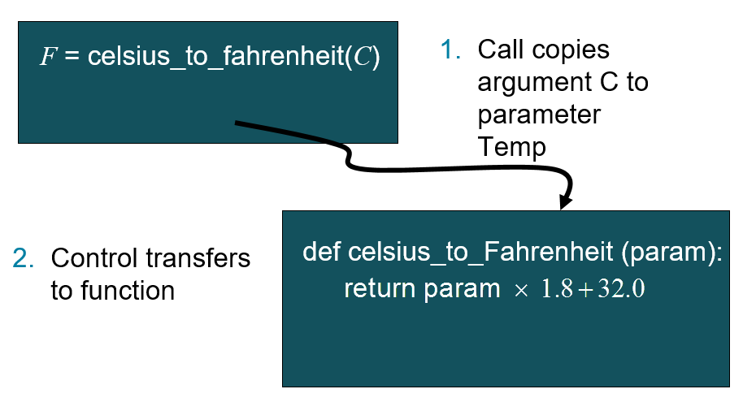
Operation (1 of 2)

Slide 13
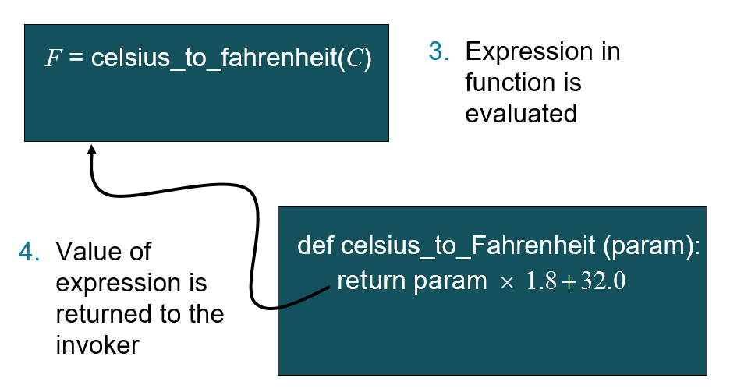
Operation (2 of 2)

Slide 14
Flow of Control With Functions
Figure 5.1 Function flow of control

Slide 15
Code Listing 5.2 : Full Temp Program

Slide 16
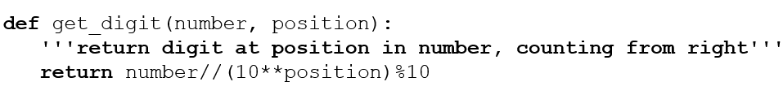
Code Listing 5.3 : Digit Extraction

Slide 17
Area of a Triangle
The next few functions can be used together to find the area of a triangle.
Note how we decompose the problem and then re-assemble the overall solution using the functions created

Slide 18
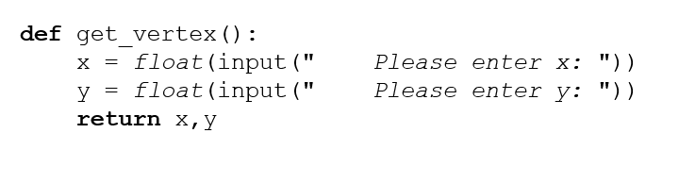
Code Listing 5.4 : Input

Slide 19
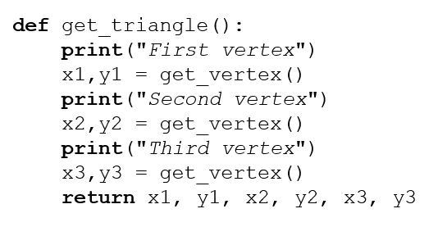
Code Listing 5.5 : get_triangle

Slide 20
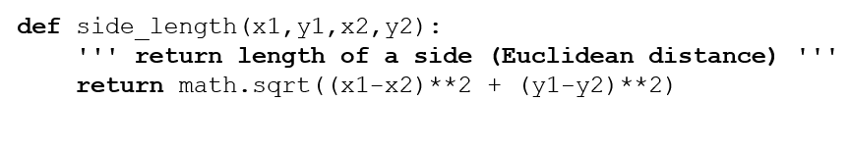
Code Listing 5.6 : side_length

Slide 21
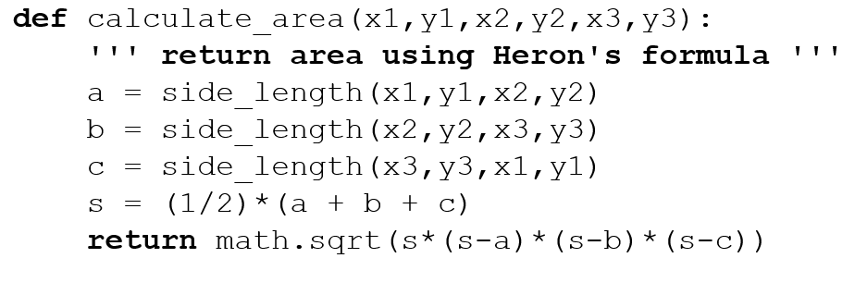
Code Listing 5.7 : calculate_area

Slide 22
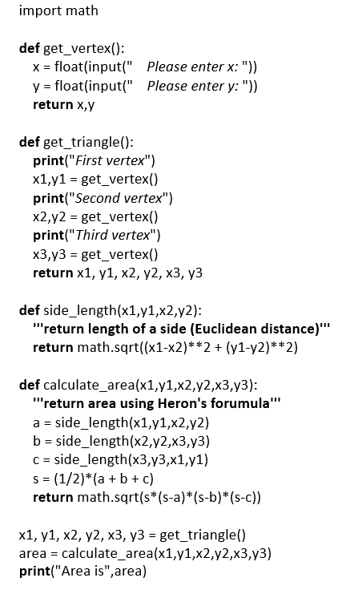
Code Listing 5.8 : Full Triangle Program

Slide 23
Did Functions Help?
Made our problem solving easier (solved smaller problems as functions)
Main program very readable (details hid in the functions)

Slide 24
How to Write a Function
Does one thing. If it does too many things, it should be broken down into multiple functions (refactored)
Readable. How often should we say this? If you write it, it should be readable
Reusable. If it does one thing well, then when a similar situation (in another program) occurs, use it there as well.

Slide 25
More on Functions
Complete. A function should check for all the cases where it might be invoked. Check for potential errors.
Not too long. Kind of synonymous with do one thing. Use it as a measure of doing too much.

Slide 26
Rule 8
A function should do one thing

Slide 27
Procedures
Functions that have no return statements are often called procedures.
Procedures are used to perform some duty (print output, store a file, etc.)
Remember, return is not required.

Slide 28
Multiple Returns in a Function
A function can have multiple return statements.
Remember, the first return statement executed ends the function.
Multiple returns can be confusing to the reader and should be used judiciously.

Slide 29
Reminder, Rules so Far (1 of 2)
Think before you program!
A program is a human-readable essay on problem solving that also happens to execute on a computer.
The best way to imporve your programming and problem solving skills is to practice!
A foolish consistency is the hobgoblin of little minds
Test your code, often and thoroughly
If it was hard to write, it is probably hard to read. Add a comment.

Slide 30
Reminder, Rules so Far (2 of 2)
All input is evil, unless proven otherwise.
A function should do one thing.

Slide 31
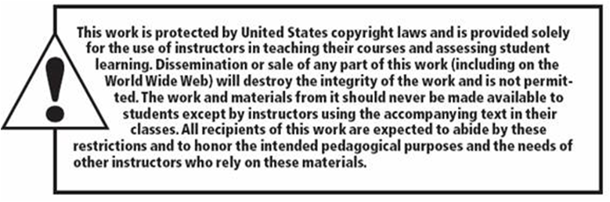
Copyright

